Slide 1
LU5 - LO2 ARCHITECTURE & INTEGRATION
Smart Supply Chain Integration
Connecting IoT, Cloud, AI, and Blockchain into a real-time, proactive operational ecosystem.
Logistics Integration
Security Layering
Real-Time Executive Dashboards

Slide 2



Operational Transformation
Operational Logistics Integration
Connected Operations
Reactive Model (Legacy)
Proactive Model (Modern)
Eliminates functional data silos across suppliers, factories, warehouses, and transport fleets.
Fixes disruptions after delivery failures occur. High operational waste and customer friction.
Predicts delivery risks in real time. Enables pre-emptive rerouting before damage occurs.

Slide 3

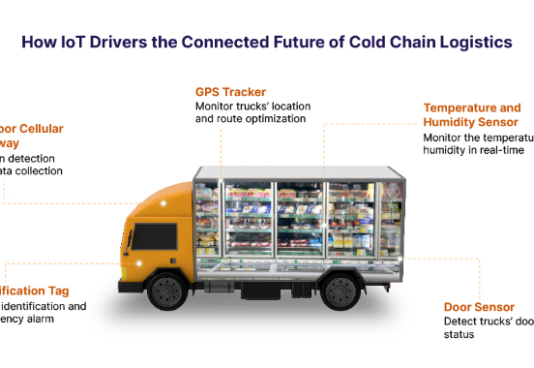
Cold Chain Scenario
Cold Chain Logistics in Action
Fresh Seafood Transit Monitoring
Continuous telemetry streams temperature (2°C), heavy traffic warnings, and GPS coordinates into central AI engines.
Automated Rerouting Decision
AI detects 5:30 PM traffic delay and recommends alternative routes to protect perishable inventory.

Slide 4
Cybersecurity Architecture
Data Security Layering
Encryption
Access Control
Blockchain
AI Threat Monitoring
Protects stored and transmitted data from unauthorized access.
Restricts sensitive operational records to authorized roles.
Provides immutable transaction history across cross-border partners.
Detects transaction anomalies and suspicious financial spikes.

Slide 5
Security Distinction
Blockchain vs. AI Security Roles
Blockchain: Record Verifiability
AI: Pattern & Anomaly Detection
Primary Role: Tamper-resistant transaction ledger.
Primary Role: Real-time behavioral surveillance.
Scope: Multi-party customs clearance and container receipts.
Scope: Flags sudden $500,000 transaction spikes.
Value: Immediate alert generation for fraud mitigation.
Value: Auditability and trust across international trade hubs.

Slide 6
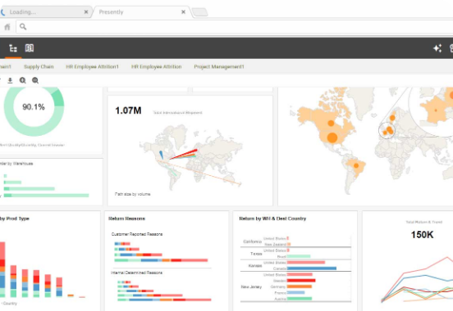
Executive Control
Real-Time Executive Decision Making
From Monthly Reports to Live Action
Consolidates store sales, traffic, and inventory telemetry across 50 retail branches into single-pane dashboards.
Dynamic Inventory Rebalancing
Transfers excess stock from Store C to low-stock Store A mid-day during demand spikes.

Slide 7

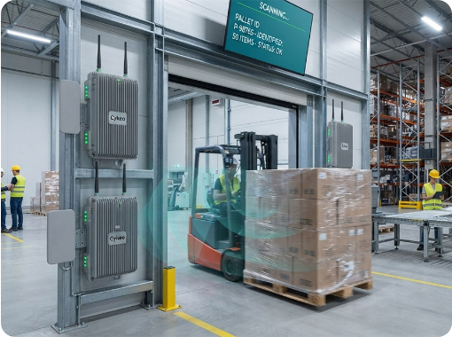
Data Acquisition
Physical Sensing & Tracking Tools
RFID Scanning
Bulk item identification without direct line-of-sight barcode scans.
GPS Tracking
Continuous fleet position coordinates and arrival estimation.
Environmental Sensors
Monitors temperature, humidity, and machine vibration metrics.

Slide 8
Dashboard Telemetry
Operational KPI Dashboard
1,245
94%
37
4.1°C
Total Active Shipments
On-Time Delivery Rate
Delayed Shipments Flagged
Avg Cold-Chain Temp
Warehouse Capacity Status
82% Utilized
26 delivery vehicles currently active across regional routes.

Slide 9
Scenario Execution
Smart Food Distribution Flow
STEP 01
STEP 02
STEP 03
STEP 04
Tag & Sense
Track & Store
Predict & Alert
Act & Verify
RFID identifies batch. Sensors log 3°C temperature.
GPS tracks truck location. IoT streams data to Cloud.
AI predicts traffic delay. Dashboard alerts manager.
Manager reroutes truck. Blockchain logs receipt.

Slide 10
Architecture Overview
The Multi-Layer Technology Stack
PHYSICAL WORLD
RFID Tags + GPS Telematics + Environmental Temperature Sensors
CONNECTIVITY
IoT Platform Gateway & Telemetry Aggregation
PROCESSING
Scalable Multi-Cloud Database Storage
INTELLIGENCE
AI Predictive Analytics & Blockchain Verifiable Audit Logs
DECISION & ACTION
Executive Dashboard Alerts → Rerouting & Inventory Rebalancing

Slide 11
Execution Formula
The Operational Integration Formula
01
02
03
04
05
06
Sense
Connect
Store
Analyse
Decide
Act
RFID & Sensors
IoT Gateways
Cloud Platform
AI Engine
Dashboards
Reroute / Adjust

Slide 12
STRATEGIC LO2 PRINCIPLE
Integration Drives Transformation, Not Isolated Tools
Digital maturity requires orchestrating RFID, GPS, Cloud, AI, and Blockchain into a synchronized, self-correcting operational architecture.

Slide 13



Image Sources
https://www.binarysemantics.com/wp-content/uploads/2025/02/How-IoT-Drivers-the-Connected-Future-of-Cold-Chain-Logistics.jpg
Source: www.binarysemantics.com
https://www.inetsoft.com/images/supply-chain-dashboard.jpg
Source: www.inetsoft.com
https://www.cykeorfid.com/wp-content/uploads/2026/07/pasted-image-20260723-062303-715.jpg
Source: www.cykeorfid.com

